Slide 1
Rosewood Hotel & Resort Case Study

Slide 2
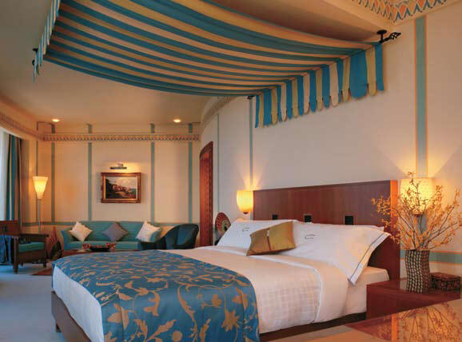
Introduction
25 years of luxury hotel management
Known for its distinctively unique luxury hotels
Has an established reputation amongst its customers
Competitors include Four Seasons,
Ritz-Carlton, and Mandarin Oriental hotels

Slide 3
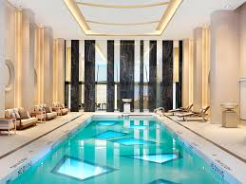
“To Brand or Not to Brand”
Introduction
New marketing in 2003
Decision between existing individual branding technique or adaptation of corporate branding strategy
Individual Branding:
Customers do not associate one Rosewood hotel with another
No brand loyalty when traveling
Limits types of customers

Slide 4
Introduction
Corporate Branding:
Exposes luxury trademark for all hotel collections
Ensures a degree of signature Rosewood quality
Draws attention to collections within brand

Slide 5
Problem Statement
“In an attempt to address the limitations of individual branding, the Rosewood corporation sought to remove the luxury brand undertone and replace it with an overt embrace of their corporate brand.”

Slide 6
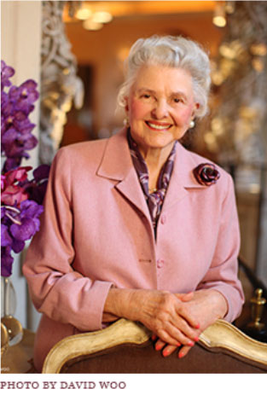

Background
Rosewood Hotels and Resorts, L.LC.
-The Caroline Rose Hunt Trust Estate
- The Mansion on Turtle Creek

Slide 7

Background
Rosewood Hotels and Resorts, L.LC.
Company Focus
Chain-like luxury hotels vs. One-of-a-kind properties

Slide 8
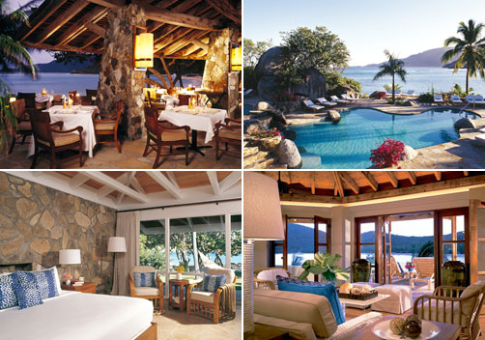
Background
Rosewood Hotels and Resorts, L.LC.
Little Dix Bay in the British Virgin Islands

Slide 9
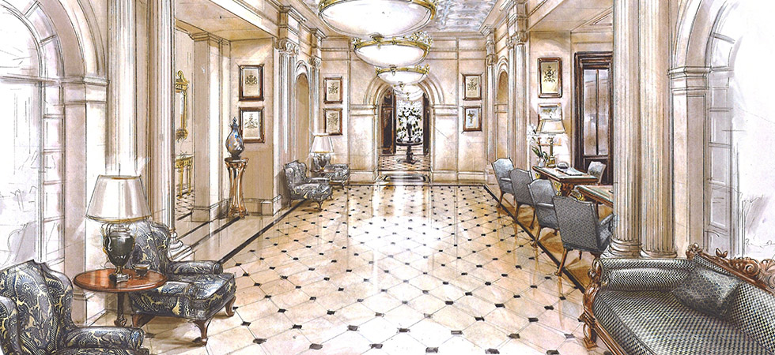
Background
Rosewood Hotels and Resorts, L.LC.
Lanesborough in London

Slide 10
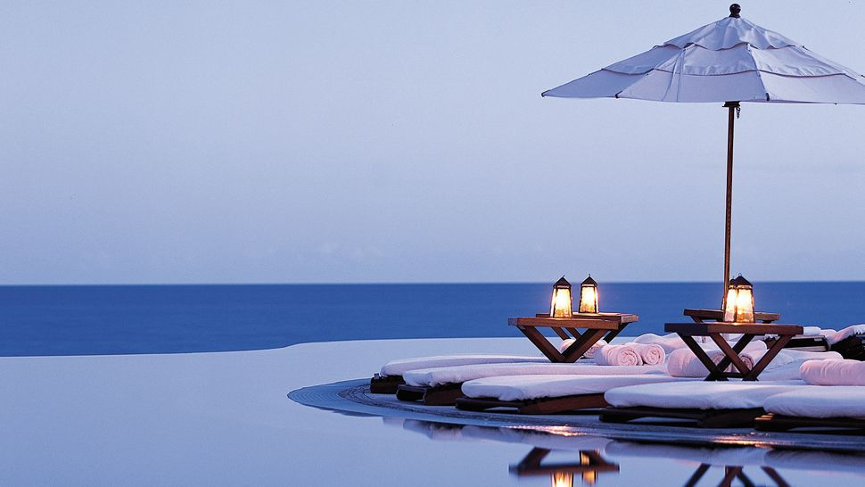
Background
Rosewood Hotels and Resorts, L.LC.
Las Ventanas Al Paraiso in Mexico

Slide 11
Background Continues….
2003
-12 Hotels Worldwide
-1513 rooms
-$120 /night-Saudi Arabia
-$9000- Canadian lodge
…a collection of unique
properties.

Slide 12
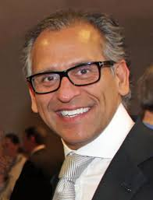
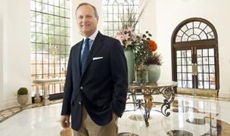
Background Continues….
CEO - John Scott
Vice President of Sales and Marketing-Robert Boulogne

Slide 13

Background Continues….
The Alarming Statistic
“While the proportion of repeat guests at a single property could reach 40%, the individual brand or collection hotel brands typically had 5% to 10% multiproperty cross-selling rates while corporate-branded hotels enjoyed 10% to 15% cross- property usage rates.”

Slide 14

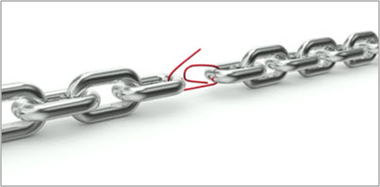
Background Continues….
The Irony of It All
The principle the company was built on exposed a deficiency and encouraged other directions

Slide 15

Goal of Analysis
Determine the effectiveness of a marketing campaign to increase brand identification
Weigh result of brand identification vs. locations branding

Slide 16
Starting Conditions
Annual Volume of Guests is 115,000.
Cost of Gaining a New Customer is $150.
Current retention is 19,169 guests with only 5,750 visiting multiple locations.
Cost of Retention is $130 per guest with an annual increase of 3%.
Annual Discounting rate is 8%.
Income from each guest is typically $750 per year with an increase of 8% per year.
The average guest stays 2 nights and 1.2 times per year.
The gross margin per guest is 32%.

Slide 17
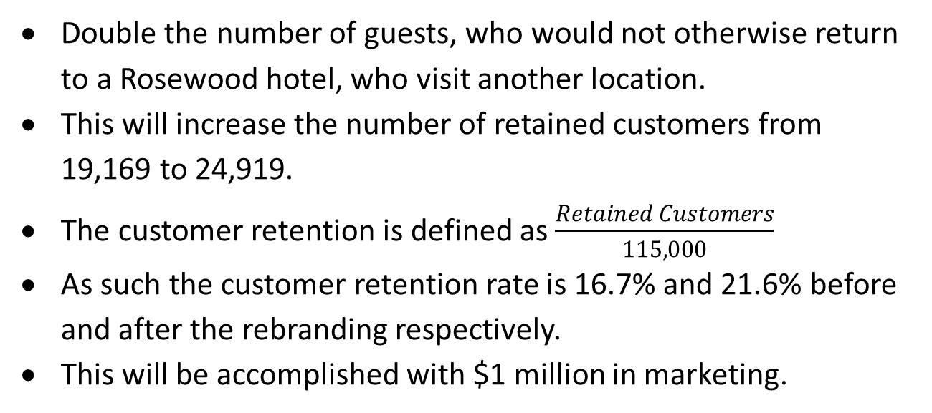
Marketing Objective
Double the number of guests, who would not otherwise return to a Rosewood hotel, who visit another location.
This will increase the number of retained customers from 19,169 to 24,919.
The customer retention is defined as $\frac{Retained Customers}{115,000}$
As such the customer retention rate is 16.7% and 21.6% before and after the rebranding respectively.
This will be accomplished with $1 million in marketing.

Slide 18
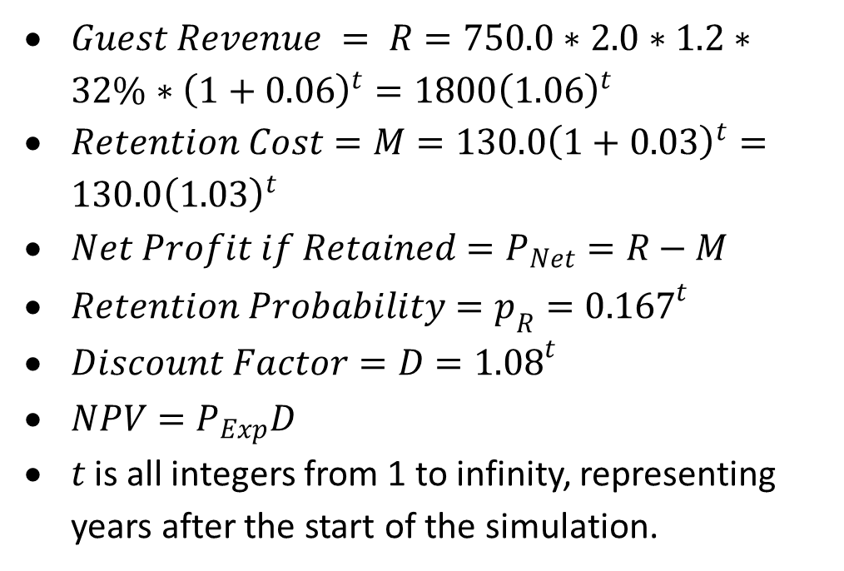
Mathematical Construction before Rebranding
$Guest Revenue = R=750.0∗2.0∗1.2∗32\%∗{\left(1+0.06\right)}^{t}=1800{\left(1.06\right)}^{t}$
$Retention Cost=M=130.0{\left(1+0.03\right)}^{t}=130.0{\left(1.03\right)}^{t}$
$Net Profit if Retained=P_{Net}=R−M$
$Retention Probability=p_{R}={0.167}^{t}$
$Discount Factor=D={1.08}^{t}$
$NPV=P_{Exp}D$
$t$ is all integers from 1 to infinity, representing years after the start of the simulation.

Slide 19
Before Rebranding
 | 2003 | 2004 | 2005 | 2006 | 2007
Number of nights per stay | n.a. | 2.0 | 2.0 | 2.0 | 2.0
Number of stays per guest | n.a. | 1.2 | 1.2 | 1.2 | 1.2
Revenue per night | n.a. | $ 795.00 | $ 842.70 | $ 893.26 | $ 946.86
Revenue per customer | n.a. | $ 1,908.00 | $ 2,022.48 | $ 2,143.83 | $ 2,272.46
Gross profit per customer | n.a. | $ 610.56 | $ 647.19 | $ 686.03 | $ 727.19
Less cost to acquire customer | (150.00) | n.a. | n.a. | n.a. | n.a.
Less annual marketing cost per customer |  | (133.90) | (137.92) | (142.05) | (146.32)
Cash flow from customer if retained |  | 476.66 | 509.28 | 543.97 | 580.87
Probability of being retained |  | 1.00 | 0.17 | 0.03 | 0.00
Expected cash flow from customer | (150.00) | 476.66 | 85.05 | 15.17 | 2.71
Discount factor | 1.000 | 1.080 | 1.166 | 1.260 | 1.360
NPV | (150.00) | 441.35 | 72.92 | 12.04 | 1.99
NPV Accumulation | (150.00) | 291.35 | 364.27 | 376.31 | 378.30

Slide 20
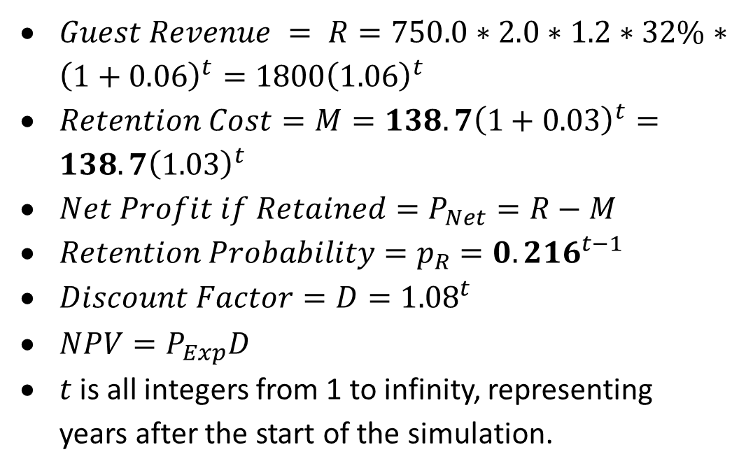
Mathematical Construction after Rebranding
$Guest Revenue = R=750.0∗2.0∗1.2∗32\%∗{\left(1+0.06\right)}^{t}=1800{\left(1.06\right)}^{t}$
$Retention Cost=M=138.7{\left(1+0.03\right)}^{t}=138.7{\left(1.03\right)}^{t}$
$Net Profit if Retained=P_{Net}=R−M$
$Retention Probability=p_{R}={0.216}^{t−1}$
$Discount Factor=D={1.08}^{t}$
$NPV=P_{Exp}D$
$t$ is all integers from 1 to infinity, representing years after the start of the simulation.

Slide 21
After Rebranding
 | 2003 | 2004 | 2005 | 2006 | 2007
Number of nights per stay | n.a. | 2.00 | 2.00 | 2.00 | 2.00
Number of stays per guest | n.a. | 1.30 | 1.30 | 1.30 | 1.30
Revenue per night | n.a. | 795 | $ 842.70 | $ 893.26 | $ 946.86
Revenue per customer | n.a. | 2067.00 | 2191.02 | 2322.48 | 2461.83
Gross profit per customer | n.a. | $ 661.44 | $ 701.13 | $ 743.19 | $ 787.79
Less cost to acquire customer | (150.00) | n.a. | n.a. | n.a. | n.a.
Less annual marketing cost per customer |  | (133.90) | (137.92) | (142.05) | (146.32)
Less additional marketing cost per customer |  | (8.96) | (9.23) | (9.50) | (9.79)
Cash flow from customer if retained | (150.00) | $ 518.58 | $ 553.98 | $ 591.64 | $ 631.68
Probability of being retained |  | 1.00 | 0.22 | 0.05 | 0.01
Expected cash flow from customer | (150.00) | $ 518.58 | $ 120.05 | $ 27.78 | $ 6.43
Discount factor | 1.000 | 1.080 | 1.166 | 1.260 | 1.360
NPV | (150.00) | $ 480.17 | $ 102.92 | $ 22.05 | $ 4.72
NPV Accumulation | (150.00) | 330.17 | 433.09 | 455.15 | 459.87

Slide 23
Final Analysis
Accumulating the probable income from both before and after rebranding the CLTV increases from $378.68 to $441.95.
Scaling this by the number of customers gives us an improvement in net profit of approximately $7.3 million.
This change in net profit fully justifies the change to a corporate branded model.

Slide 24
Recommendation
Corporate brand broadcasted
Customer relationship management
Happy employees = happy customers
Word of mouth recommendations

Slide 25
Conclusion
Corporate Name Recognition
Corporate Image
Corporate Loyalty
Corporate reputation

Slide 26


